Slide 1
Partitioning and Divide-and-Conquer Strategies

Slide 2
Partitioning
Partitioning simply divides the problem into parts.
Divide and Conquer
Characterized by dividing problem into sub-problems of same form as larger problem. Further divisions into still smaller sub-problems, usually done by recursion.
Recursive divide and conquer amenable to parallelization because separate processes can be used for divided parts. Also usually data is naturally localized.
4.1

Slide 3
Partitioning/Divide and Conquer
Examples
Many possibilities.
• Operations on sequences of number such as simply adding them together
• Several sorting algorithms can often be partitioned or constructed in a recursive fashion
• Numerical integration
• N-body problem
4.2

Slide 4
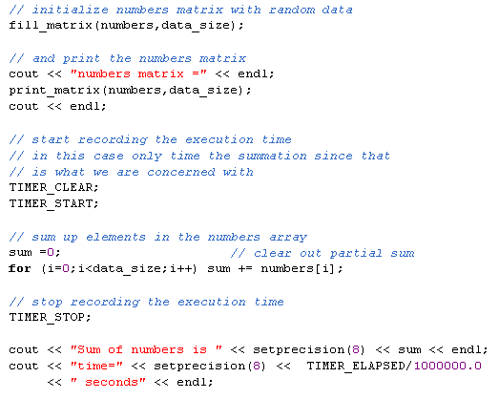
Example: Adding a sequence of Numbers (serial version)

Slide 5
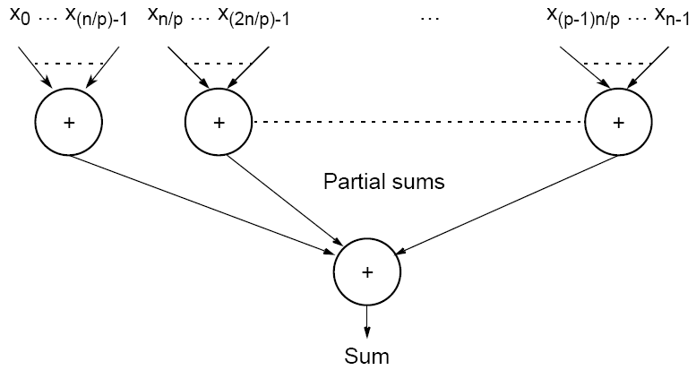
Partitioning a sequence of numbers into parts and adding the parts
4.3

Slide 6
Divide and Conquer
Characterized by dividing problem into sub-problems of same form as larger problem. Further divisions into still smaller sub-problems, usually done by recursion.
The divide-and-conquer technique is effective in parallel computing when the sub-problems generated by problem partitioning can be solved concurrently and are of approximately equal sizes.

Slide 7
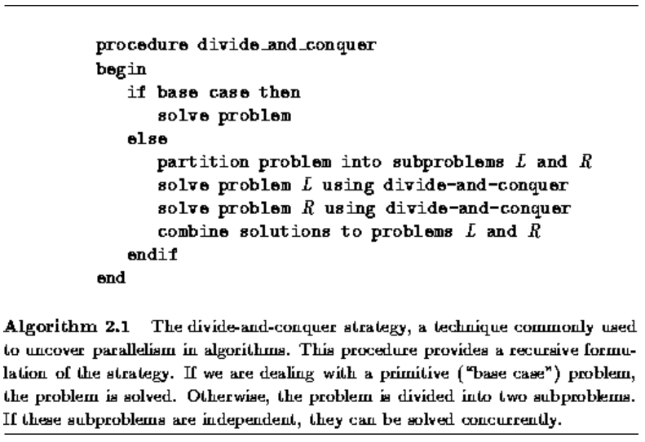
Divide and Conquer

Slide 8
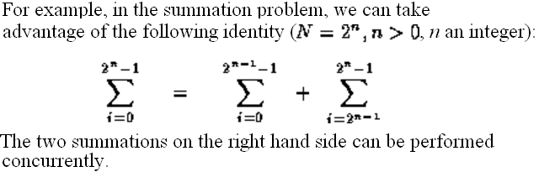
Divide and Conquer Example: Parallel Reduction Operation (summation)
This process can be continued on both the left and right portions of the problem until only two numbers need to be added together.

Slide 9
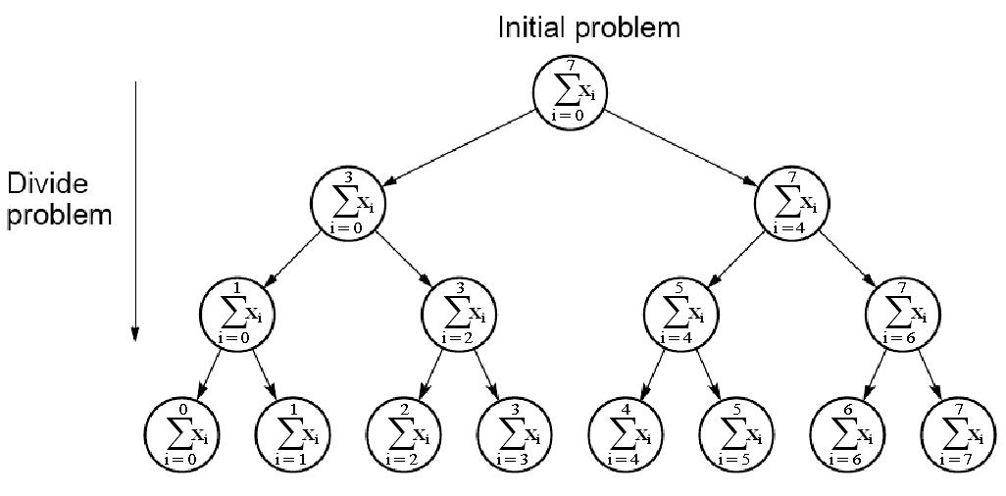
Divide and Conquer Example: Parallel Reduction Operation (summation)
Summations at the same level in this tree of height n=log₂N can be performed concurrently, so the complete summation can be achieved in log₂N rather than N steps.

Slide 10
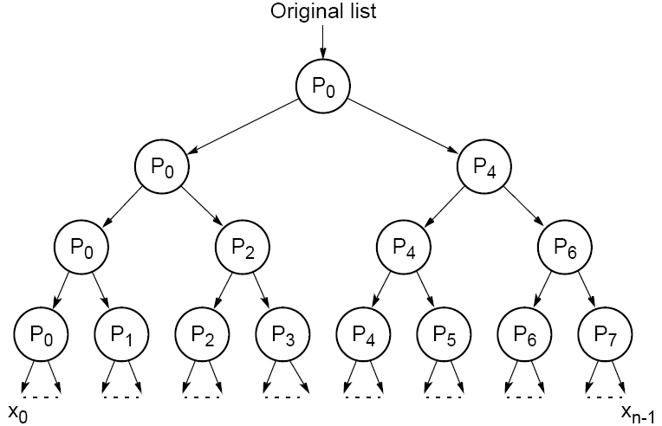
Dividing a list into parts
4.5

Slide 11
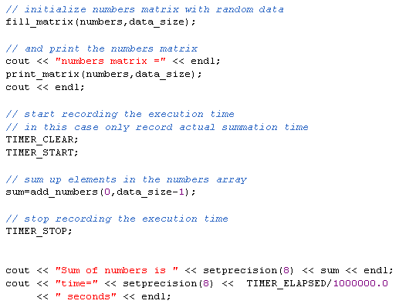
Divide and Conquer (serial/recursive implementation)

Slide 12
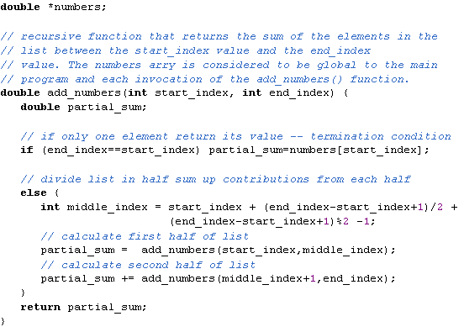
Divide and Conquer (serial/recursive implementation)

Slide 13
Global Communication Example: Parallel Reduction Operation (summation)
The parallel reduction algorithm is efficient:
the N-1 communication and computation operations are distributed among the tasks.
the order in which these operations are performed has been modified so that they can proceed concurrently.
The result is a regular communication structure in which each task communicates with a small set of neighbors.

Slide 14
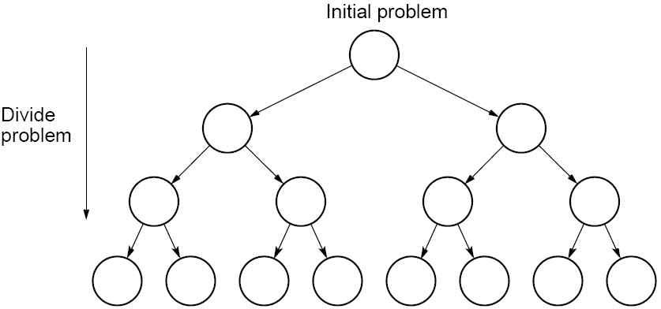
Tree construction
4.4

Slide 15
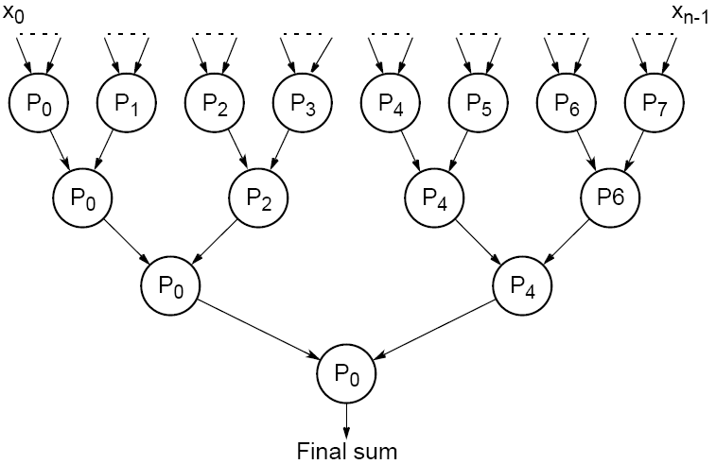
Partial summation
4.6

Slide 16
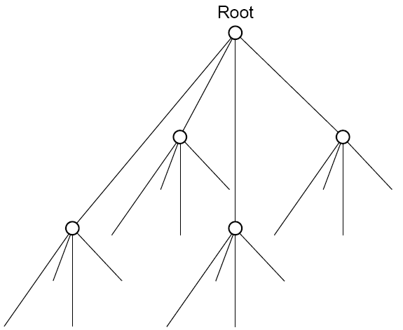
Quadtree
4.7

Slide 17
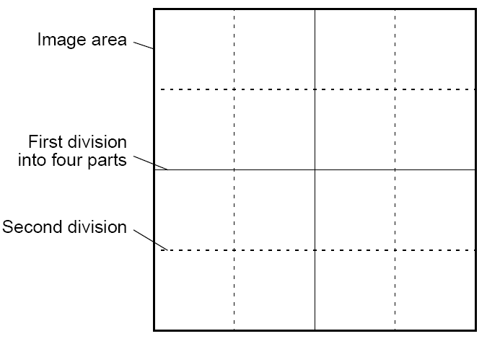
Dividing an image
4.8

Slide 18
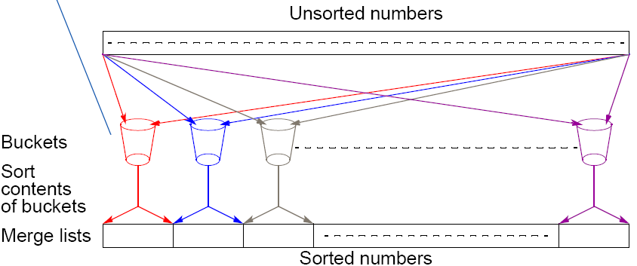
Bucket sort
One “bucket” assigned to hold numbers that fall within each region.
Numbers in each bucket sorted using a sequential sorting algorithm.
Sequential sorting time complexity: O(nlog(n/m).
Works well if the original numbers uniformly distributed across a known interval, say 0 to a - 1.
4.9

Slide 19
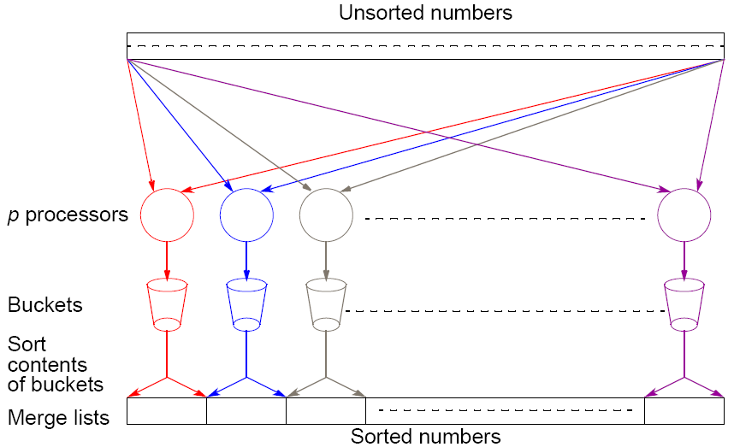
Parallel version of bucket sort
Simple approach
Assign one processor for each bucket.
4.10

Slide 20
Further Parallelization
Partition sequence into m regions, one region for each processor.
Each processor maintains p “small” buckets and separates numbers in its region into its own small buckets.
Small buckets then emptied into p final buckets for sorting, which requires each processor to send one small bucket to each of the other processors (bucket i to processor i).
4.11

Slide 21
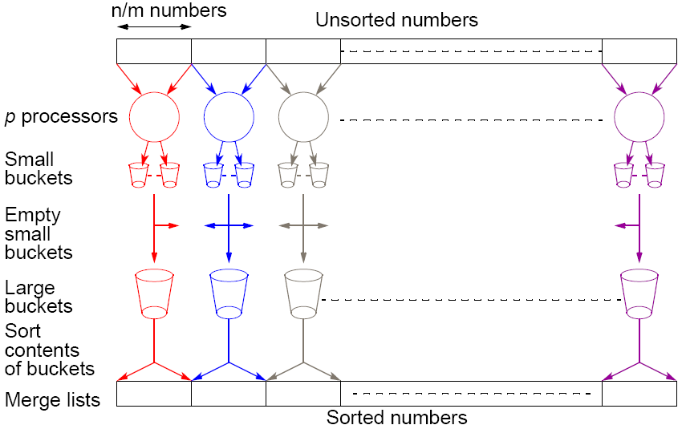
Another parallel version of bucket sort
Introduces new message-passing operation - all-to-all broadcast.
4.12

Slide 22
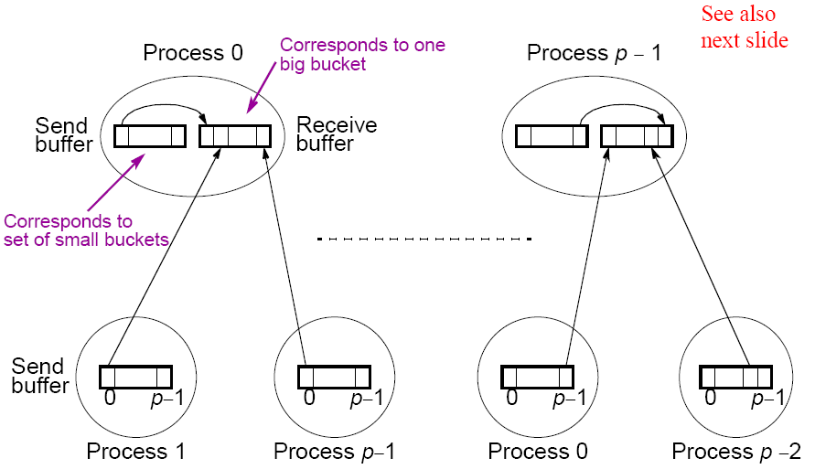
“all-to-all” broadcast routine
Sends data from each process to every other process
4.13

Slide 23
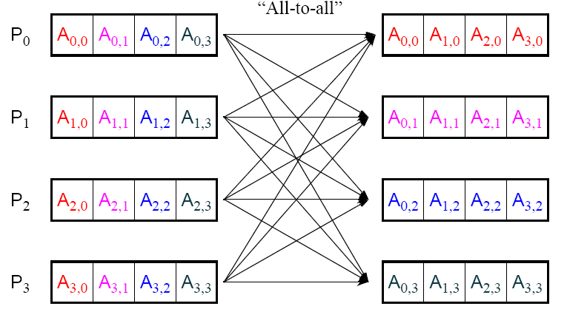
“all-to-all” routine actually transfers rows of an array to columns:
Transposes a matrix.
4.14

Slide 24
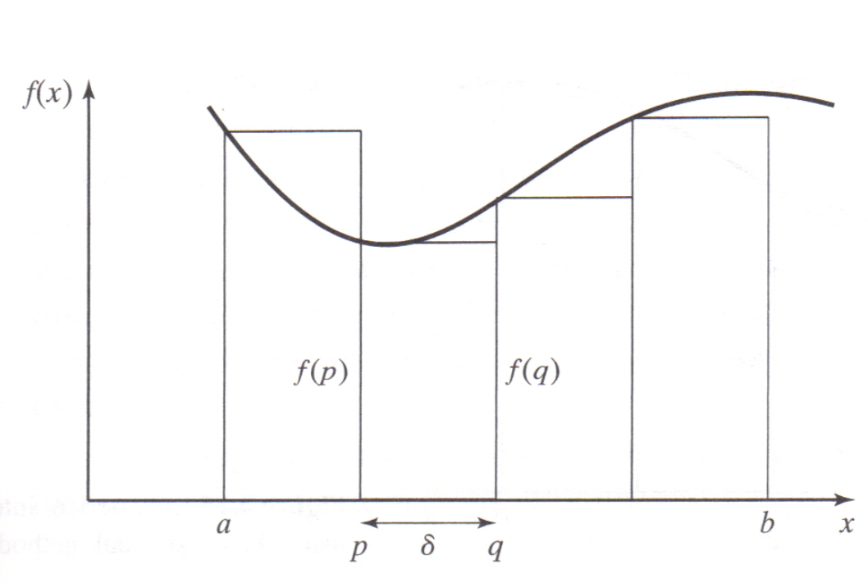
Numerical integration using rectangles
Each region calculated using an approximation given by rectangles:
Aligning the rectangles:

Slide 25
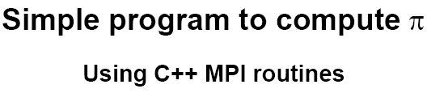
3.19

Slide 26
/***********************************************************************
pi_calc.cpp calculates value of pi and compares with actual
value (to 25 digits) of pi to give error. Integrates function f(x)=4/(1+x^2).
July 6, 2001 K. Spry
***********************************************************************/
using namespace std;
#include <iostream>
#include <math.h> //include files
#include "mpi.h"
void printit() {
cout << "\n*********************************" << endl
<< "Welcome to the pi calculator!" << endl
<< "Programmer: K. Spry" << endl
<< "You set the number of divisions \nfor estimating the"
<< "integral: \n\tf(x)=4/(1+x^2)"
<< endl
<< "*********************************" << endl;
} //end printit
4.20

Slide 27
int main(int argc, char *argv[]) {
//for comparison later
double actual_pi = 3.141592653589793238462643;
int n, rank, num_proc, i;
double temp_pi, calc_pi, int_size, part_sum, x;
char response = 'y', resp1 = 'y';
MPI::Init(argc, argv); //initiate MPI
num_proc = MPI::COMM_WORLD.Get_size();
rank = MPI::COMM_WORLD.Get_rank();
if (rank == 0) printit(); /* I am root node, print out welcome */
while (response == 'y') {
if (resp1 == 'y') {
if (rank == 0) { /*I am root node*/
cout <<"__________________________________" <<endl;
cout <<"\nEnter the number of intervals: (0 will exit)"
<< endl;
cin >> n;}
}
else n = 0;
MPI::COMM_WORLD.Bcast(&n, 1, MPI::INT, 0); //broadcast n
4.21

Slide 28
if (n==0) break; //check for quit condition
else {
int_size = 1.0 / (double) n; //calcs interval size
part_sum = 0.0;
for (i = rank + 1; i <= n; i += num_proc) {
//calcs partial sums
x = int_size * ((double)i - 0.5);
part_sum += (4.0 / (1.0 + x*x));
}
//collects all partial sums computes pi
temp_pi = int_size * part_sum;
MPI::COMM_WORLD.Reduce(&temp_pi,&calc_pi, 1,
MPI::DOUBLE, MPI::SUM, 0);
4.23

Slide 29
// On the Root Print out calcuated pi and error
if (rank == 0) {
cout << "pi is approximately " << calc_pi
<< ". Error is " << fabs(calc_pi - actual_pi)
<< endl
<<"_______________________________________"
<< endl;
}
} //end else
if (rank == 0) { /*I am root node*/
cout << "\nCompute with new intervals? (y/n)" << endl;
cin >> resp1;
}
} //end while
MPI::Finalize(); //terminate MPI
return 0;
}
4.22

Slide 30
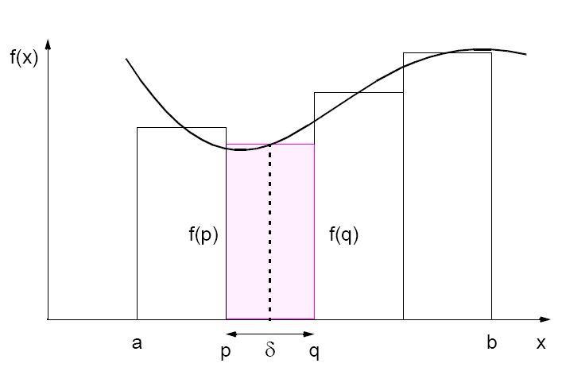
Numerical integration using rectangles
Each region calculated using an approximation given by rectangles:
Aligning the rectangles:
4.15

Slide 31
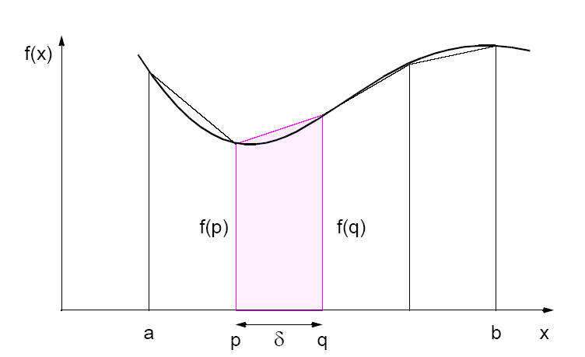
Numerical integration using trapezoidal method
May not be better!
4.16

Slide 32
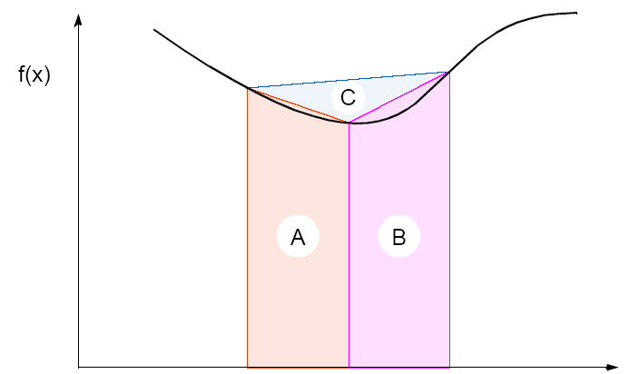
Adaptive Quadrature
Solution adapts to shape of curve. Use three areas, A, B, and C. Computation terminated when largest of A and B sufficiently close to sum of remain two areas .
4.17

Slide 33
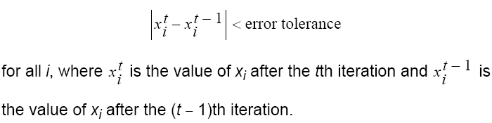
Termination
A simple, common approach. Compare values computed in one iteration to values obtained from the previous iteration. Terminate computation when all values are within given tolerance; i.e., when
However, this does not guarantee the solution to that accuracy.
6.34

Slide 34
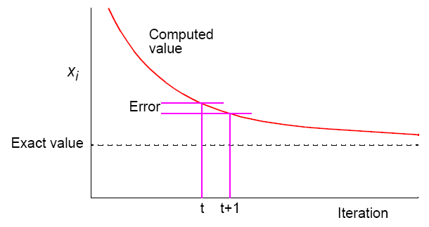
Convergence Rate
6.35

Slide 35
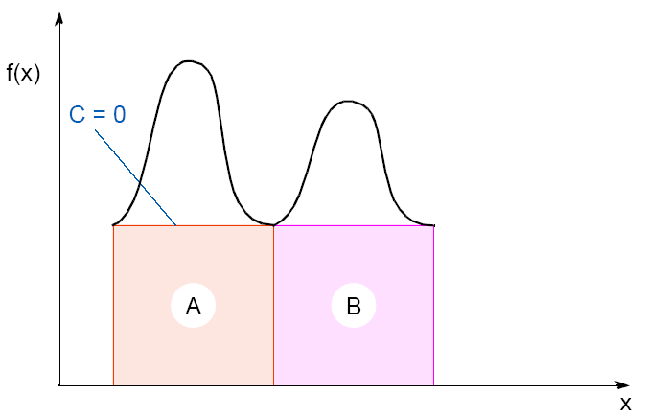
Adaptive quadrature with false termination.
Some care might be needed in choosing when to terminate.
Might cause us to terminate early, as two large regions are the same (i.e., C = 0).
4.18

Slide 36
4.24

Slide 37
Gravitational N-Body Problem
Finding positions and movements of bodies in space subject to gravitational forces from other bodies, using Newtonian laws of physics.
4.25

Slide 38

Gravitational N-Body Problem Equations
Gravitational force between two bodies of masses m_{a} and m_{b} is:
G is the gravitational constant and r the distance between the bodies. Subject to forces, body accelerates according to Newton’s 2nd law:
F = ma
m is mass of the body, F is force it experiences, and a the resultant acceleration.
4.26

Slide 39
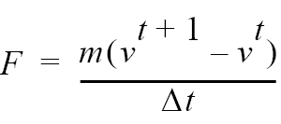
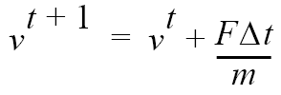

Details
Let the time interval be t. For a body of mass m, the force is:
New velocity is:
where v^{t+1} is the velocity at time t + 1 and v^{t} is the velocity at time t.
Over time interval Δt, position changes by
where x^{t} is its position at time t.
Once bodies move to new positions, forces change. Computation has to be repeated.
4.27

Slide 40
Sequential Code
Overall gravitational N-body computation can be described by:
for (t = 0; t < tmax; t++) /* for each time period */
for (i = 0; i < N; i++) { /* for each body */
F = Force_routine(i); /* compute force on ith body */
v[i]new = v[i] + F * dt / m; /* compute new velocity */
x[i]new = x[i] + v[i]new * dt; /* and new position */
}
for (i = 0; i < nmax; i++) { /* for each body */
x[i] = x[i]new; /* update velocity & position*/
v[i] = v[i]new;
}
3.28

Slide 41
Parallel Code
The sequential algorithm is an O(N²) algorithm (for one iteration) as each of the N bodies is influenced by each of the other N - 1 bodies.
Not feasible to use this direct algorithm for most interesting N-body problems where N is very large.
4.29

Slide 42
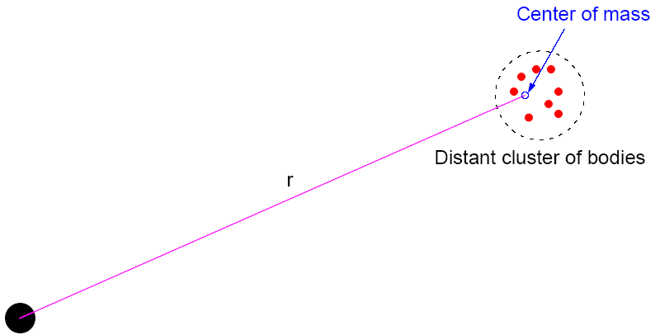
Time complexity can be reduced approximating a cluster of distant bodies as a single distant body with mass sited at the center of mass of the cluster:
4.30

Slide 43
Barnes-Hut Algorithm
Start with whole space in which one cube contains the bodies (or particles).
• First, this cube is divided into eight subcubes.
• If a subcube contains no particles, subcube deleted from further consideration.
• If a subcube contains one body, subcube retained.
• If a subcube contains more than one body, it is recursively divided until every subcube contains at most one body.
4.31

Slide 44
Creates an octtree - a tree with up to eight edges from each node.
The leaves represent cells each containing one body.
After the tree has been constructed, the total mass and center of mass of the subcube is stored at each node.
4.32

Slide 45

Force on each body obtained by traversing tree starting at root, stopping at a node when the clustering approximation can be used, e.g. when:
where is a constant typically 1.0 or less.
Note: d is overall dimensions d x d x d
r is distance to center of mass
and is the opening angle
Constructing tree requires a time of O(nlogn), and so does computing all the forces, so that overall time complexity of method is O(nlogn).
4.33

Slide 46
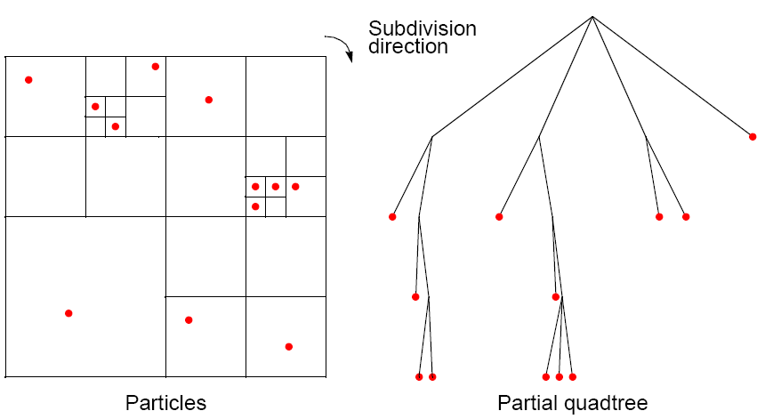
Recursive division of 2-dimensional space
4.34

Slide 47
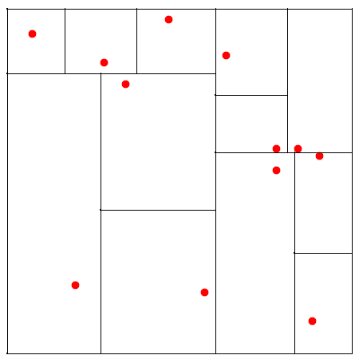
Orthogonal Recursive Bisection
(For 2-dimensional area) First, a vertical line found that divides area into two areas each with equal number of bodies. For each area, a horizontal line found that divides it into two areas each with equal number of bodies. Repeated as required.
4.35

